Slide 1
Rockbuster Stealth:
Data Analysis
By Joel Perez , Data Analyst

Slide 2
OVERVIEW:
Rockbuster Stealth LLC is a movie rental company that used to have stores around the world. Facing stiff competition from streaming services such as Netflix and Amazon Prime, the Rockbuster Stealth management team is planning to use its existing movie licenses to launch an online video rental service in order to stay competitive. .
The Rockbuster Stealth Management Board has asked a series of business questions and they expect data-driven answers that they can use for their 2020 company strategy.

Slide 3
OBJECTIVES:
Determine which movies contributed the most and least to the revenue gain in Rockbuster.
Provide insights into the average rental duration for all videos in Rockbuster.
Identify the countries where Rockbuster customers are based.
Determine the locations of customers with a high lifetime value for Rockbuster.
Analyze whether there is a variation in sales figures between geographic regions in Rockbuster

Slide 4
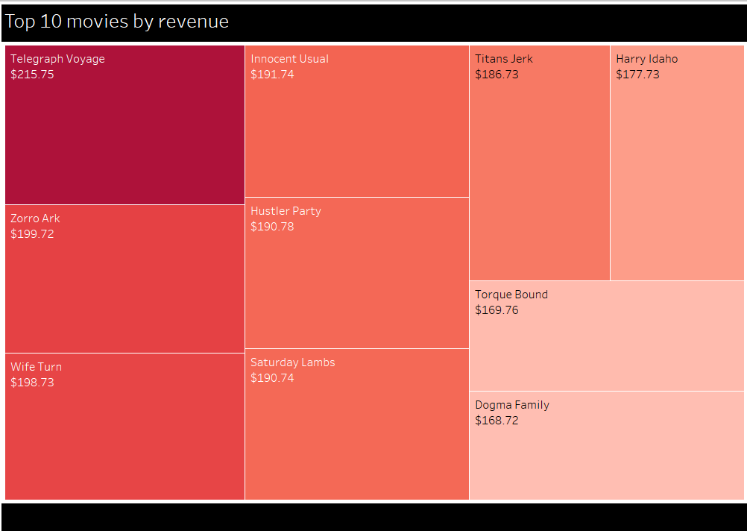
Which movies contributed the most to revenue?
Here we have a Treemap representing the top revenue movies for Rockbuster.
Telegraph Voyage
Was the highest grossing movie with $216.75 earned.

Slide 5
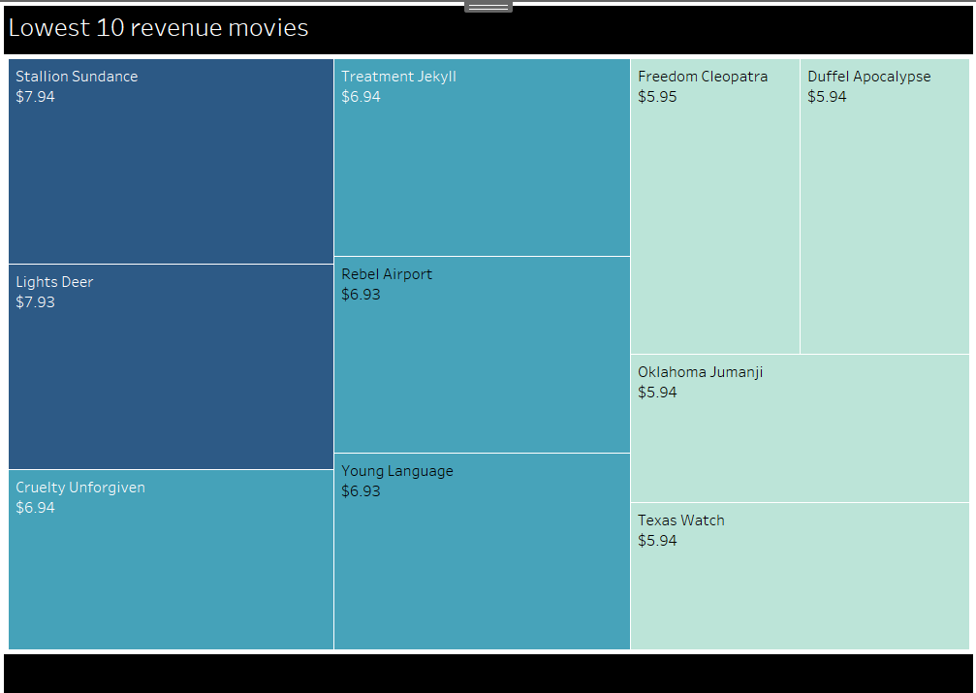
Which movies contributed the least to revenue?
This Treemap represent the lowest revenue movies for Rockbuster.
Texas Watch
Was the lowest grossing movie with $5.94 earned.

Slide 6
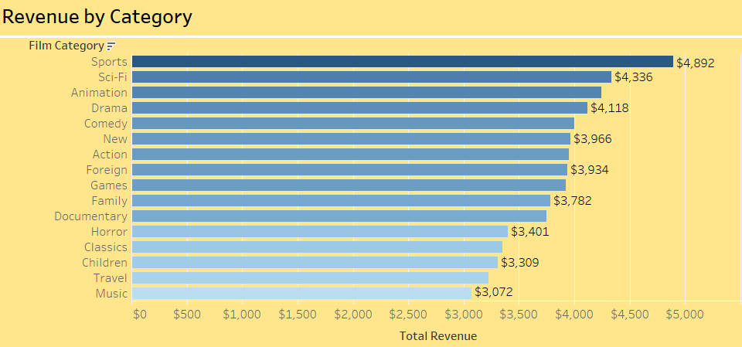
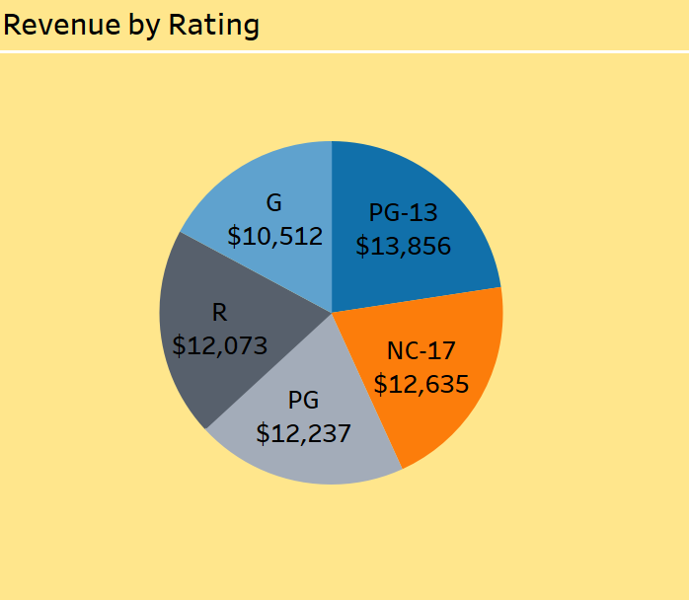

Revenue by Genre & Rating
This bar chart represents the amount of Revenue by Genre.
Sports is the most viewed Genre with $4,892 earned.
Music is the lowest Genre with $3,072 earned
This pie chart represents the amount of Revenue by Rating.
PG-13 is the most viewed Rating with $13,856 earned.
G is the lowest Rating with $10,512 earned

Slide 7
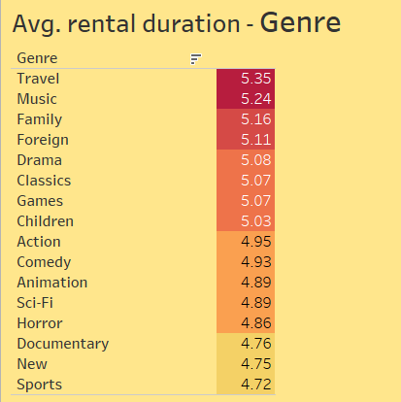
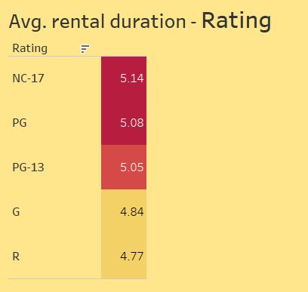
What was the Average rental duration?
Days
Days
We can see by these charts that Rockbuster’s rental avg is between 4-5 days. With Travel(genre) & NC-17(rating) having the highest rental avg.

Slide 8
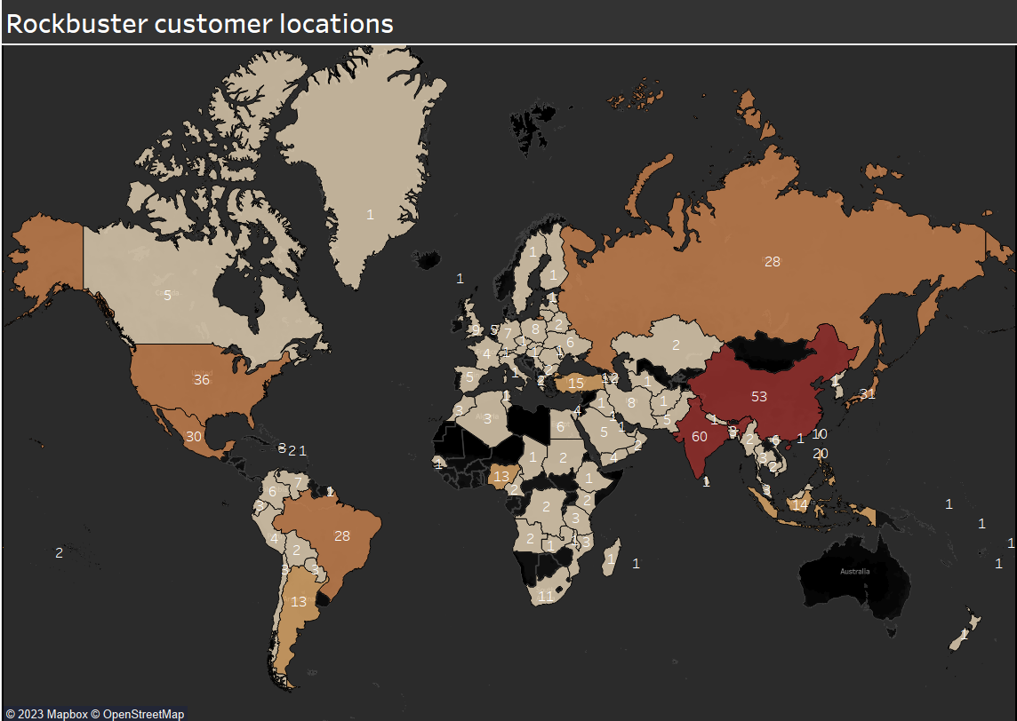
Which countries are Rockbuster customers based in?
Rockbuster is based out of 108 countries.
In this map we can see how many customers there are in each region, with the darker shades being home to higher number of customers.
India has the most customers with 60.
Top 5:
India
China
United States
Japan
Mexico

Slide 9
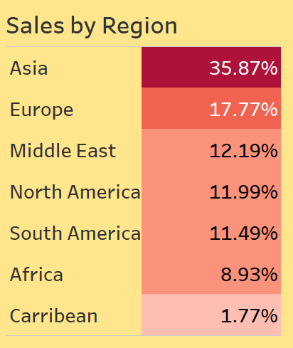
Do sale figures vary between geographic regions?
Sales vary from region, here we can how much each region accounts for total sales.
Asia is by far the highest grossing region. With almost double the number of sales than the next highest sales region.

Slide 10
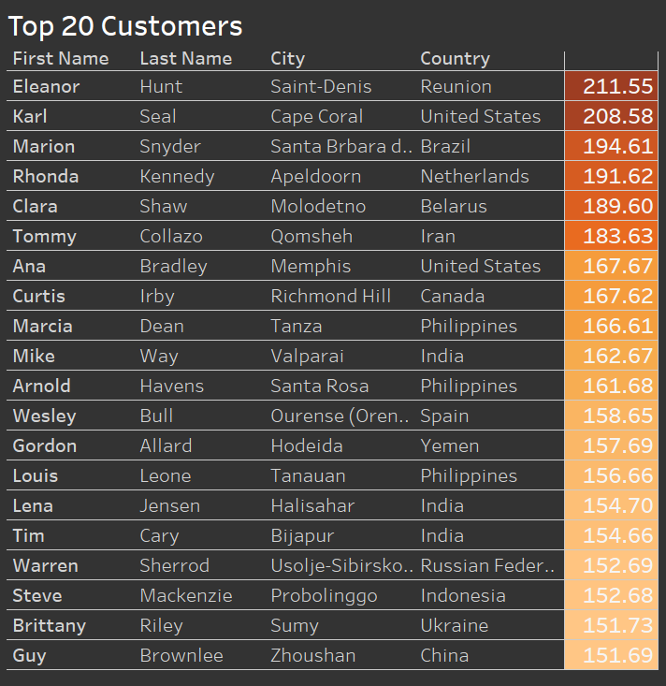
Where are customers with a high lifetime value based?
High lifetime value customers can be found all around the world. With Saint-Denis in Reunion being home to Rockbusters top spending customer.
Both India and the Philippines have the most customers in the top 20 with 3 each.

Slide 11
Recommendations:
In order to maximize revenue during launch of the online video service, Rockbuster should promote its top 10 highest grossing movies. With these tried and tested films, Rockbuster can attract higher volume of customers and drive higher traffic through the video service website.
Subsequently, Rockbuster should stop paying for the lowest 10 grossing movies and use those funds and acquire new licenses for more recent and popular films.
To effectively use the marketing budget, Rockbuster should prioritize the Asian market. This region has the high population and loyal customers. By focusing on this market, Rockbuster can expand on the customer base it had, and potentially attract the greatest number of customers. After this market, the rest of the budget should be allocated between the other top regions, Europe > Middle East > North America > South America.
To expand their customer base and revenue, Rockbuster should conduct analysis into what is working in the Asian region and apply those findings and insights to other regions that are not performing as well. Conducting customer satisfaction surveys and preferences, Rockbuster can expand the streaming catalog with popular and fan favorite films that will attract more customers from different Regions.

Slide 12
Thanks
Do you have any questions?
joel.pr@icloud.com
Tableau link:
Rockbuster Stealth | Tableau Public

